Slide 1
CSC175 Spring 2026 Sample Exam Quesitos
Notes:
Slides template credit: Josh Hug, Lisa Yan

Slide 2
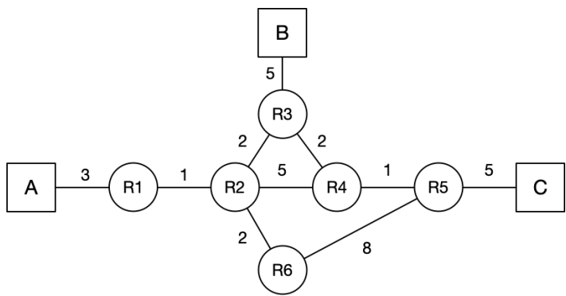
Lecture 5.3 - Link-State
Consider the following network graph with three hosts (A, B, C) and six routers (R1 - R6). For the following questions, assume that the routers run a link-state routing protocol and the routing state has converged. Every link is up unless otherwise noted. When picking between equal-cost paths, the routers pick the route through the neighbor with the lower ID number.
Note that all subparts are independent questions (changes made in one subpart do not affect the subsequent ones).
Q1. Suppose that the link between R3 and R4 goes down. R3 and R4 have recomputed their routes, but they have not yet sent updates. What route will a packet from A to C take?
Q4.2 (2 points) Suppose that the link between R2 and R3 goes down. R2 and R3 have recomputed their
routes, but have not yet sent updates. What route will a packet from A to C take?
Notes:
then after that after the midterm maybe we switch into layer four
14:15
and we start thinking about how do you actually build a reliable protocol so we showed you that little super simple Bob
14:21
sending 10 packets reliability protocol and some people pointed out there are some bugs in that that we didn't really
14:27
address and you're right a real solid state-of-the-art reli reliability protocol will take us four lectures to
14:34
build so we're going to spend two lectures building TCP to ensure reliability and then we'll spend two
14:40
more lectures talking about congestion control so that we ensure that the NH host don't overload the links and these
14:47
are associated with the third project which is all about transport and implementing
14:52
TCP and then after that two lectures at layer seven so we're basically moving up the stack and at layer seven there
14:59
there's two applications that we'll talk about one of them is DNS one of them is HTTP I won't talk about them any further
15:05
here because you'll get them a lot later but there are examples of things that we can build on top of the network to make
15:12
everything work and once we've traveled across all the layers in lecture 16 and 17 we'll go back and clean up all the
15:19
little missing pieces that we haven't really touched yet to form what we call the end to endend picture so by lecture
15:26
17 you will finally get the ultimate picture of what exactly happens when I send a packet from point A to point B
15:32
all of the missing pieces will get filled in we'll go through all these protocols that didn't really fit anywhere else but have to be covered and
15:40
we'll also spend a little bit of time at Layer Two and everything will be connected up so we'll spend a lot of time at layers three four and seven and
15:47
once we do that we'll Circle back and tie it all together in lectures 16 and 17 so that's the next part of the
15:57
semester

